Slide 2
The 5th International Congress of Exercise and Sport Sciences
June 7-10 2018
Tel Aviv
Nicos Kartakoullis

Slide 3
Strategic Planning in Sport Organizations:
Is it possible to implement?

Slide 4
Topics:
Do sports organizations need strategic plans? Do they need a strategy?
What is the current situation?
The role of Sport and Exercise Sciences (Academia) in supporting the implementation of strategy.

Slide 5
Why strategize?
Inspires managers (vision)
Auditing the business
Identifying opportunities
Guides structuring and supports decision making
Setting objectives
Common language for stakeholders
(Wickham, 2001)

Slide 6
Setting SMART objectives for sports organizations

Slide 7
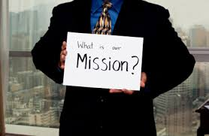
What is the current situation regarding strategic planning in sports organizations?
Organizations that have strategic plans
Organizations that do not have strategic plans
Organizations that do have but do not implement!
Why?

Slide 8
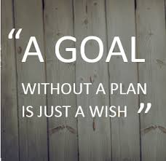
Reasons for the absence of strategic planning:
Time
Knowledge / Expertise
Lack of trust, openness (Accountability?)

Slide 9
Exercise and Sport Sciences → Sport Management
The need for a JOINT EFFORT

Slide 10
Content of presentations – 5th Congress
Innovative
Interesting
Pioneering
Useful?
Utilization?
Research → its contribution to the successful implementation of strategy

Slide 11
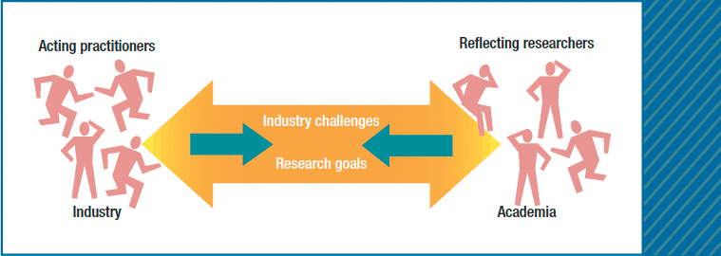
Two schools of thought:
The practioners’ point of view
The Academic / Scientific point of view
Bringing the two together is the major challenge

Slide 12
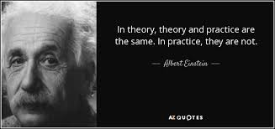
The link between theory and practice
Decision makers in Sports Organizations → Do they understand the importance of research (academia) as a critical success factor in developing their organization / sport?
Does this reflect in the strategic plans of sport organizations?

